Slide 1
COMPOSTING
Innovative technologies for climate change mitigation by Mediterranean agricultural sector– Clima MED
LIFE17 CCM/GR/000087
https://life-climamed.eu/home

Slide 2
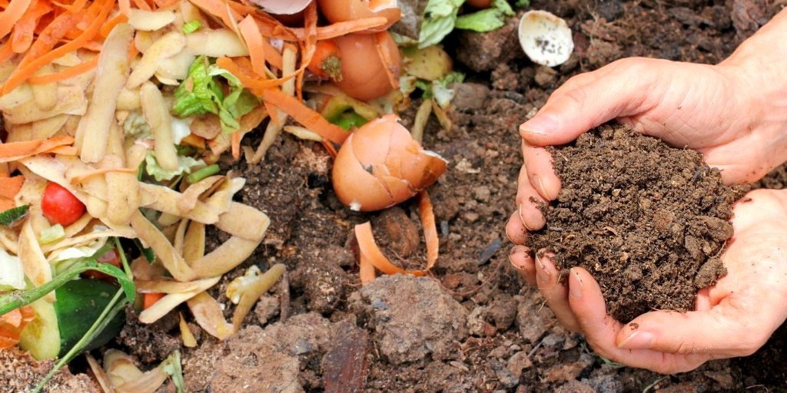
What is composting?
Composting is a representation of the natural decomposition process, where optimal conditions are reproduced to speed up the process. Agriculture waste can be used, such as crop residues, gardening waste, food waste and animal manure. The resulting material ends up looking like fertile soil. Farmers also refer to it as ‘Black Gold’, because it maintains soil fertility and is rich in nutrients.

Slide 3
Benefits of composting
Environmental Benefits
Reduces the Waste Volume reaching the landfills
One third of the food produced worldwide ends up in landfills. This create the need of expanding or creating new landfill areas destroying natural habitats in the process. Apart from that, even with the best landfill practices organic, inorganic heavy metals are leaching to groundwater.
Methane emissions are avoided
Organic waste that end up in landfills are subject to anaerobic conditions, meaning that microorganisms cannot decompose the organic matter. Instead, anaerobic decomposition produces methane,
Waste is regenerated into valuable resource
Compost is a carbon-rich fertilizer. By composting nutrient loss is avoided and reintroduced back in the system closing the loop.

Slide 4
Benefits of composting
Benefits for the Farmer
Increase Organic Matter
Compost is an organic fertilizer and can easily increase the Soil Carbon Content (SOC). Organic matter enhance the soil’s ability to store and supply essential nutrients and absorb toxic substances.
Improve Soil Structure and Nutrients
Adding organic matter in the soil, the soil structure and fertility is improved, helping crop establishment. Water infiltration and retention capabilities are boosted allowing the plants continuous growth, saving water and reducing water erosion.

Slide 5
Benefits of composting
Benefits for the Farmer
Save on Fertilizers
Organic waste is turned into fertilizer instead of sending them in landfills. Compost can enhance the performance of inorganic fertilizers and avoid nutrient leaching, reducing the fertilizer quantity needed.
Increase Crop Productivity and Plant Health
Compost provide the plants with beneficial microorganisms that help them defend themselves against pest and diseases. It also increases the soil capacity to balance soil pH levels, avoiding soil acidification.

Slide 6
Role of Organic Matter
Biology
Physics
Chemistry
Source of carbon and Nutrients
Water Retention
Cation Exchange Capacity (CEC)
Buffer Capacity
Resilient soil-plant system
Soil Structure
Thermal Properties

Slide 7
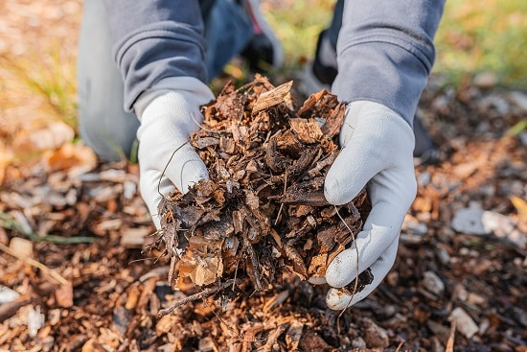
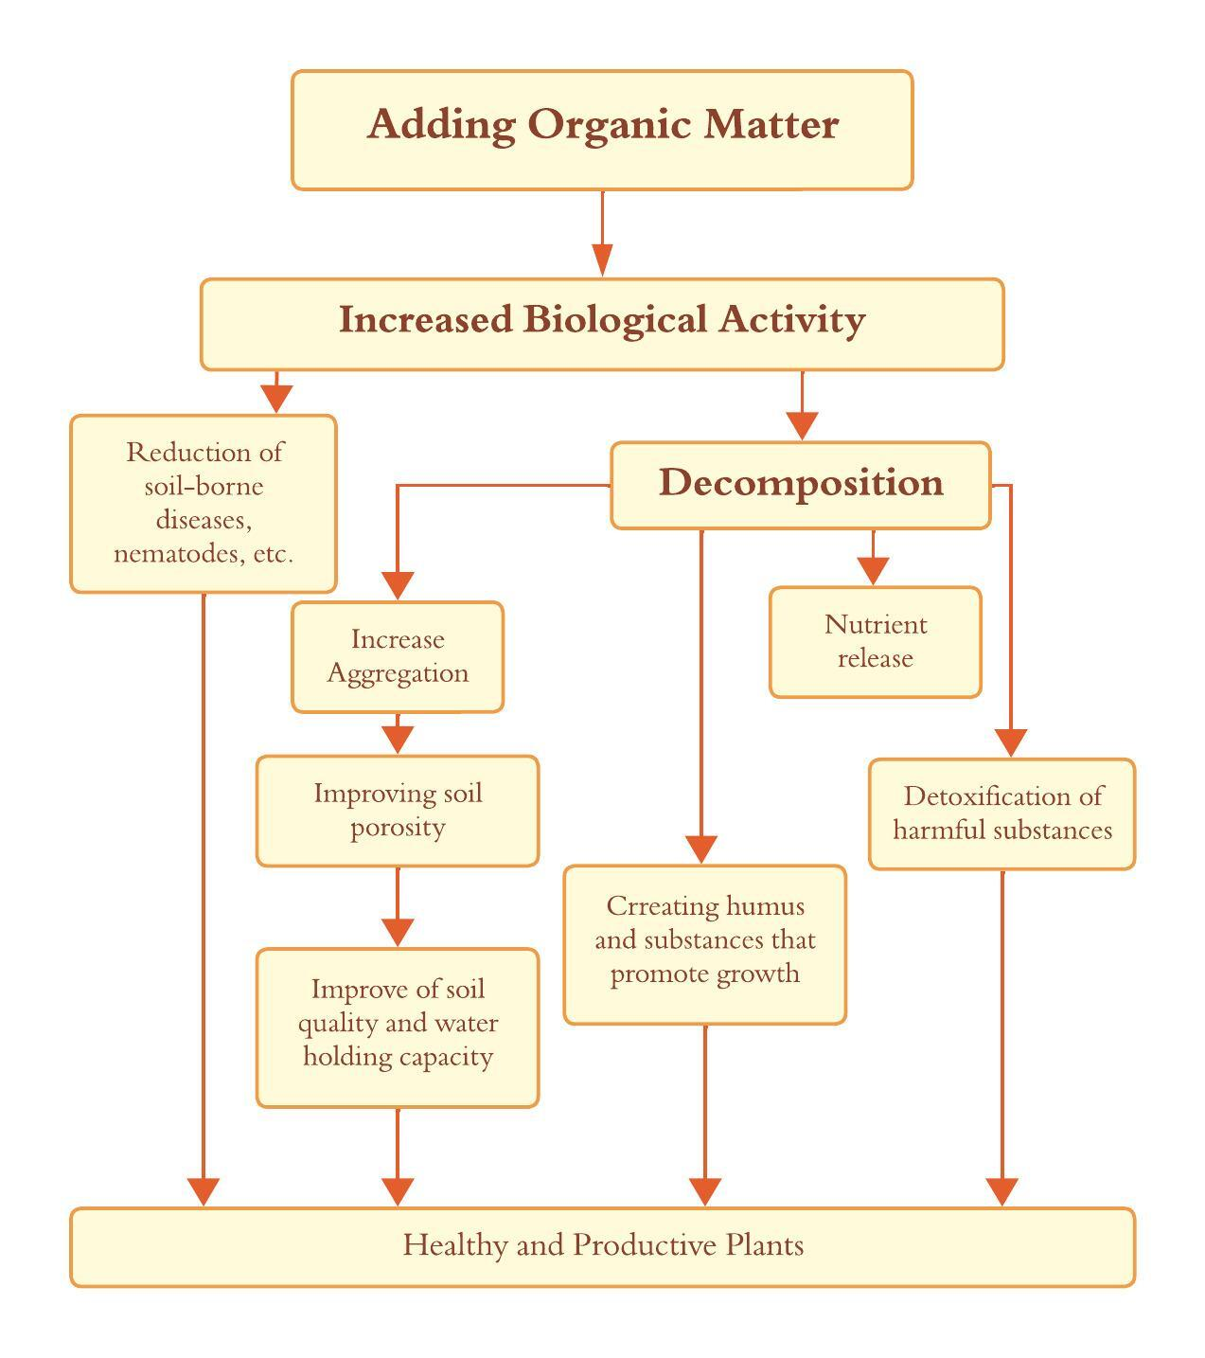
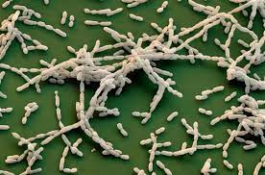
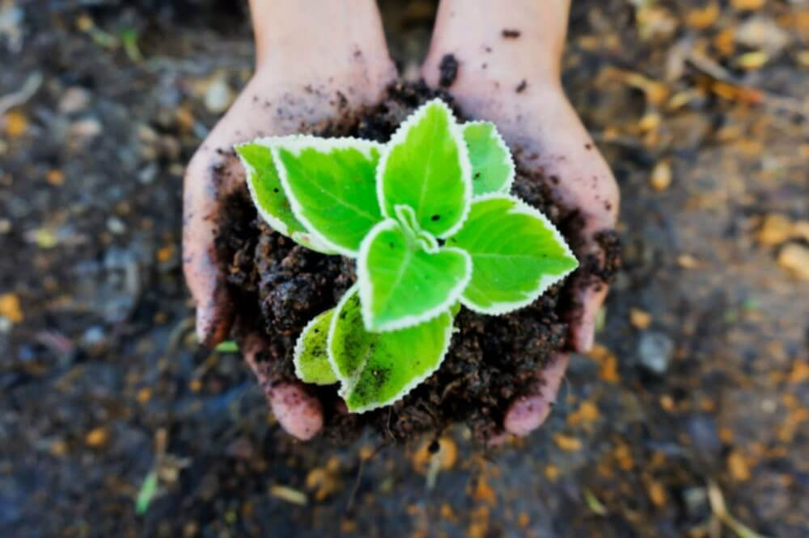

Slide 8
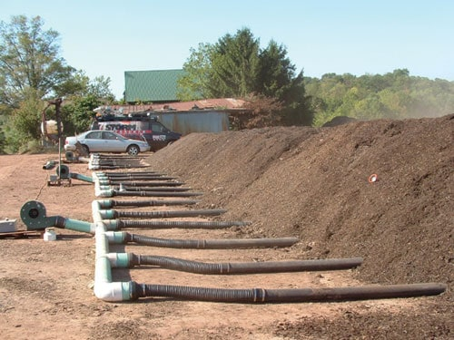
Composting Methods
Static piles
Agricultural waste is stacked in elongated piles and the composting process occurs without turning. Perforated pipes are installed in the base of the pile to ensure proper aeration and facilitate airflow. This is important to sustain microbial activity and control temperature. If needed blowers are used to force the air through the pile.
The method is less labor intensive but it may take longer time.

Slide 9
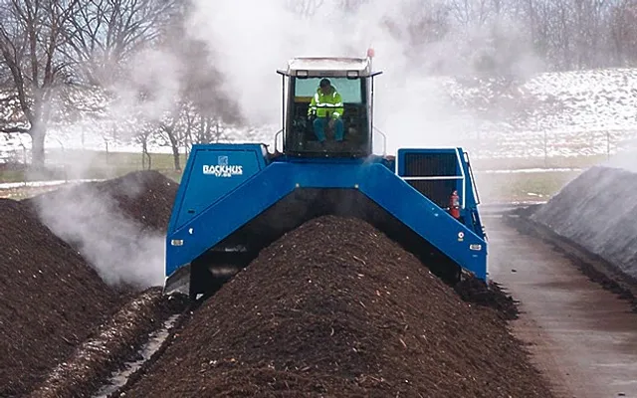
Composting Methods
Windrow or Elongated piles
Agricultural residues are stacked in long, narrow piles known as windrows. In contrast with static piles, windrows are regularly turned or mixed to ensure aeration and speed up decomposition.
Suitable for large quantities of waste and requires specialized compost turning machinery.

Slide 10
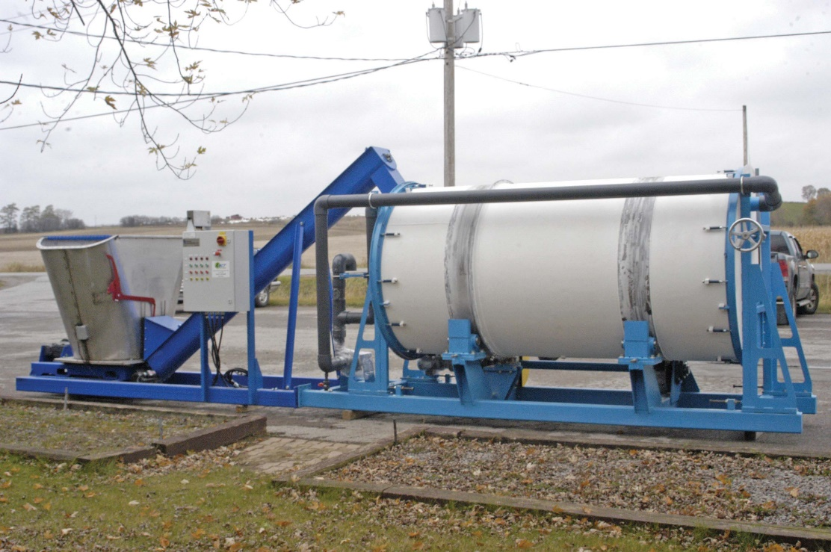
Composting Methods
In-vessel (enclosed) composting
Organic waste is placed in enclosed containers or structure to compost agricultural waste. This method allows for more control over temperature and moisture levels. In-vessel composting is ideal for composting agricultural waste where odor control, space limitation or rapid composting are essential.
The capital and running cost
are higher than other methods.

Slide 11
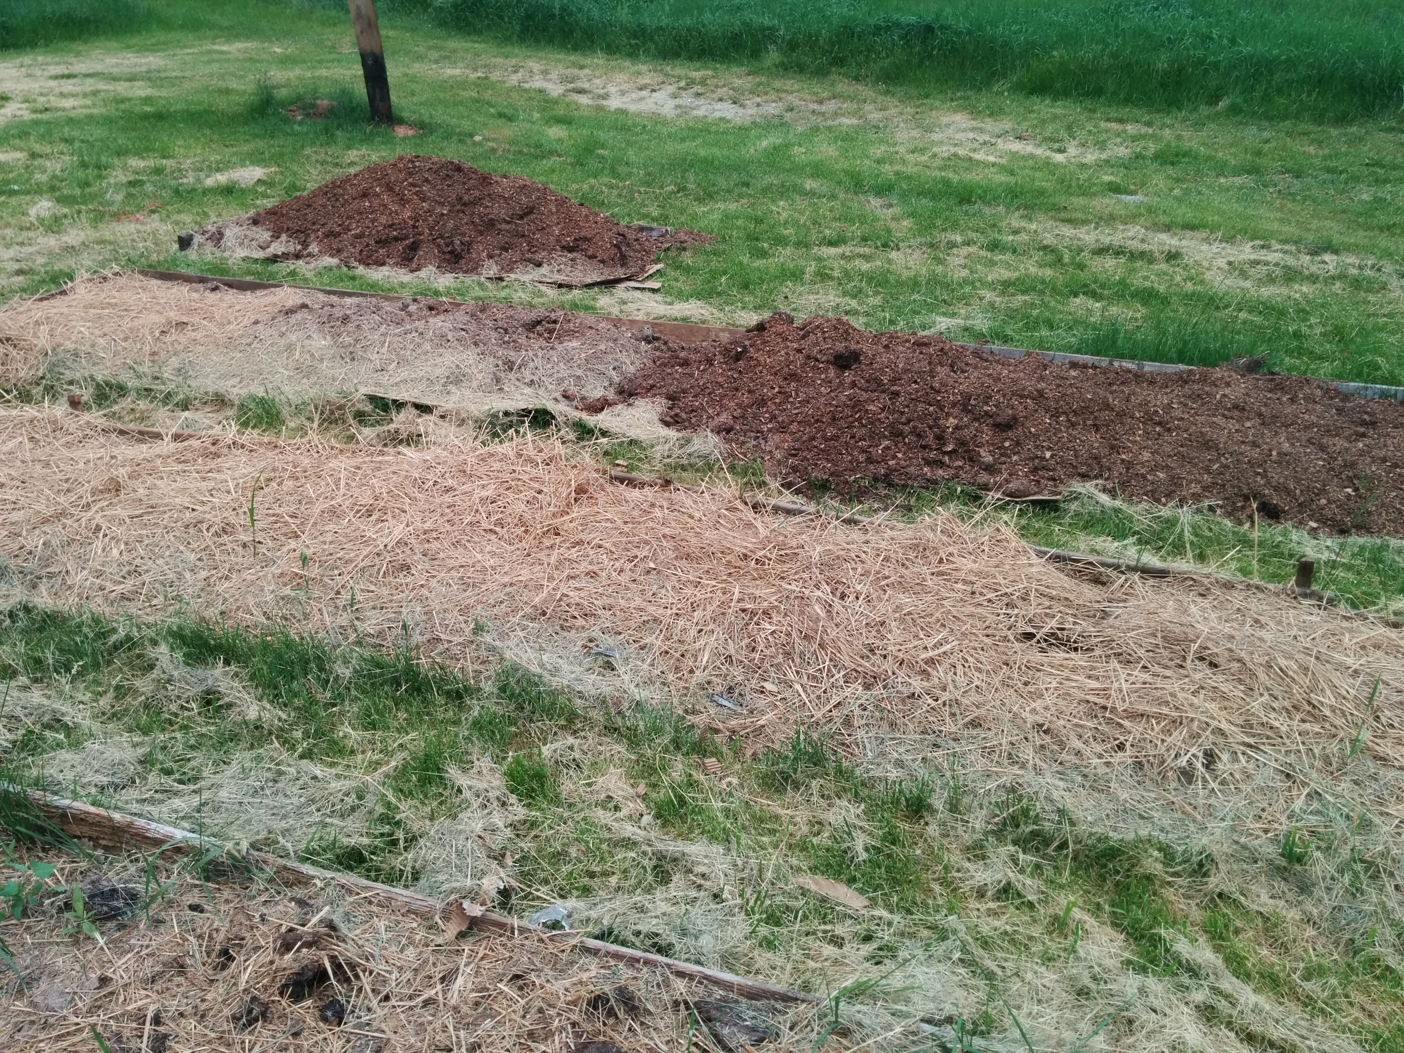
Composting Methods
Sheet composting
Crop residues and agricultural waste can directly incorporated in the soil into the top soil by using plows or tillage equipment.
The process is slow but the decomposed organic
material can enrich the soil with nutrients
and improve soil structure.

Slide 12
How to make compost
Compost is formed from the activity of several microorganisms, and other larger living organisms like worms and insects. Providing optimal environmental conditions for living organisms can speed up the process and improve the quality of compost. To achieve this, the following parameters must be at optimal levels:
type of organic matter
moisture
temperature
air
acidity (depends mostly in air and moisture flow)

Slide 13
Type of Organic Matter
The optimal carbon-to-nitrogen ratio (C:N) is 25-30:1.
This ratio depends on the compost ingredients used in the process. The key for successful composting is to achieve a balanced mix of nitrogen (green) rich and carbon (brown) rich materials.
Τhe green materials are nitrogen-rich and include fruits and vegetable scraps, coffee grounds, fresh grass and plant trimmings.
The brown materials are carbon-rich and include residues such as straw, hay, dried leaves and cardboard.
Woody materials contain high percentages of lignin and chitin and need to be shredded to break down easier. Food waste is full of carbohydrates and sugars and easily breaks down in the first stages. Be careful not to use toxic materials
Surface area of compost material: The smaller the size of organic materials, the greater the surface that decomposers can work on.
When the ratio drops below 20:1 the compost is considered mature.

Slide 14
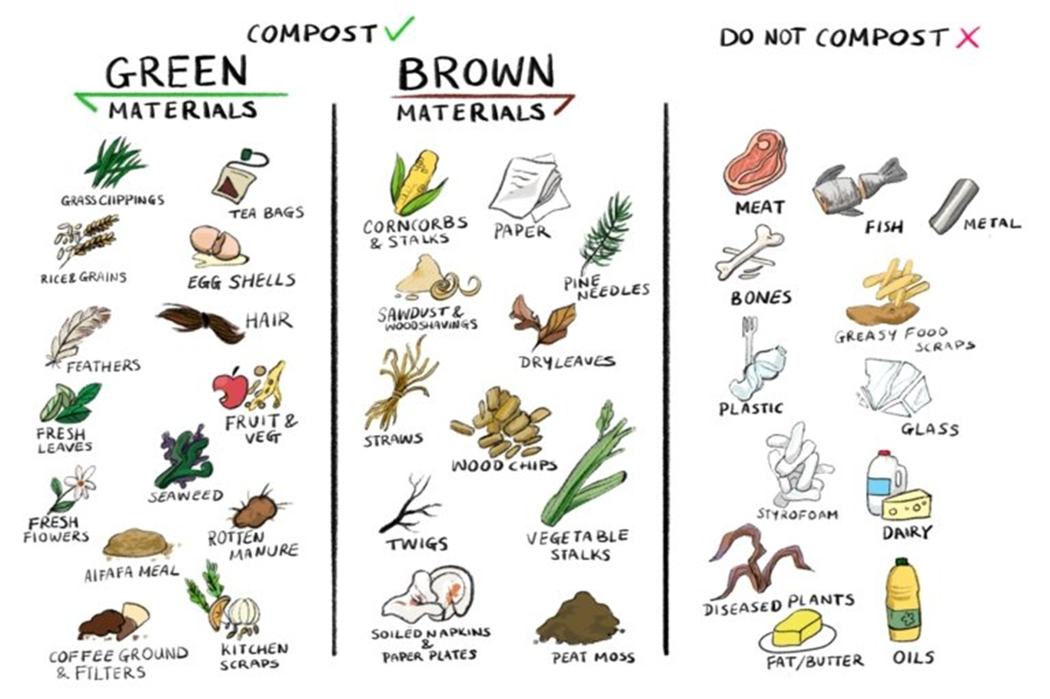

Slide 15
How to make compost
Compost is formed from the activity of several microorganisms, and other larger living organisms like worms and insects. Providing optimal environmental conditions for living organisms can speed up the process and improve the quality of compost. To achieve this, the following parameters must be at optimal levels:
type of organic matter
moisture
temperature
air
acidity (depends mostly in air and moisture flow)
The composting process is divided in three phases: Heating phase, Cooling down phase and Curing phase

Slide 16
Moisture
A critical component for a successful composting process, as it directly impacts the microbial activity in the composting pile. Water helps the microorganisms to spread in the compost pile and carry essential nutrients and energy in their cell membranes, making water essential for their survival. Therefore, if the moisture is below the desired level, microbial activity is limited and decomposition process slows down.
However, if there is excess of water in the compost pile the pores spaces are filled reducing the available oxygen to microorganisms. The composting process slows down and pile temperature drops down. Anaerobic composting may occur if the moisture is too high, making the mixture smelly.
The optimal moisture content level
throughout the process is between 40-60%.

Slide 17
Temperature
Critical factor that determines the microbial community.
Sudden drops in temperature can slow down the process and hinder the remediation objectives. When the compost pile temperature remains cool during the thermophilic phase, it might indicate lack of nitrogen-rich materials or poor aeriation.
Adding nitrogen rich (green) materials and turning the pile more often can help maintain the optimal level.
Higher temperatures can also slow down the biological activity and cause undesirable chemical modifications in the mixture. Turning the pile more often can help to cool it down by providing sufficient aeriation.

Slide 18
Composting and control parameters
Composting
Heating Phase
Mesophilic Stage
Thermophilic Stage
Cooling Phase
Maturation Phase

Slide 19
Composting Stages Temperature

Slide 20
Aeriation
Aeriation provides oxygen essential for the survival of microorganism responsible for decomposing.
Adequate aeration ensures that the composting process proceeds efficiently, helps prevent foul odors, and promotes the breakdown of organic materials.
The optimal oxygen level for compost process is 5-10%.
Therefore, the carbon dioxide produce from the microorganisms during the process need to be blown out to prevent the emergence of microorganisms that don’t require oxygen.
Depending on the chosen compost method aeriation can be done in different ways:
Turning or Flipping the pile
Using aeration tools (compost aerator rods or composting forks)
Aeriation pipes
Adding Bulky materials

Slide 21
Acidity
Acidity levels can significantly affect the activity of microorganisms and therefore the speed of composting. That is why measuring acidity can help us monitor the process and implement corrective measures.
Optimum pH levels during composting are between 5.5 – 8.5.
The initial pH of the mixture depends on the composition of the organic matter.
As the mixture progresses to maturation the pH rises as the organic acids break down and volatilized. Ammonia is also released by microbes as they break down proteins and other sources of organic nitrogen.
Mature compost attains a pH between 6-8.

Slide 22
Step by step composting process
Step 1: Choose a Composting Method
Decision of composting method according to the available space
Step 2: Select a Composting Location
Composting location should be level, easily accessible and well drained area.
Step 3: Gather the Composting Materials
Combination of green and brown materials to achieve the recommended 25:1 ratio.
Step 4: Start layering
The base of the pile is initially constructed using a layer of brown materials. Next, a coating of green substance. Following is an alternate arrangement of brown and green materials.

Slide 23
Step by step composting process
Step 5: Provide aeriation
If the method requires rotation of the pile, then the aeration process is also performed
Step 6: Maintain Moisture and Temperature levels
Maintaining humidity and temperature at regular intervals. Where necessary, water is added to increase humidity or rotation to decrease temperature.
Step 7: Patience and Time
The composting process can take a few months to a year depending on the composting parameters and weather conditions. When ready, the organic materials will turn into a dark, crumbly compost
Step 8: Harvest your compost

Slide 24
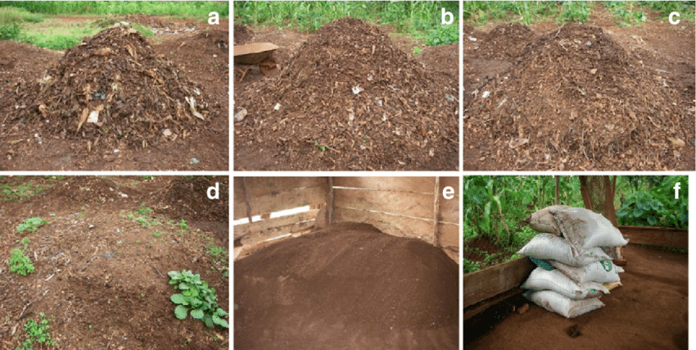
Step by step composting process

